Slide 1
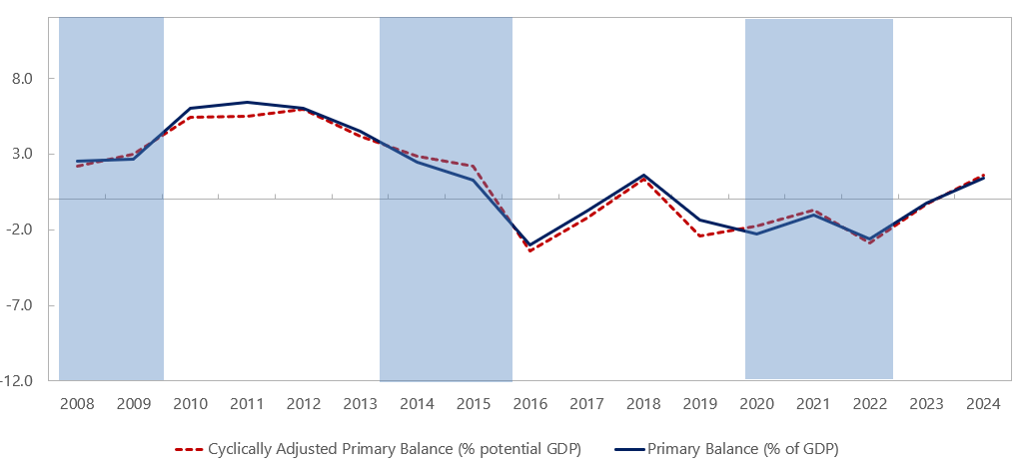
Fiscal stance has been expansionary since pre-covid coupled with risks
Primary Balance & Cyclically Adjusted Primary balance
(% of GDP)
Fiscal policy has been instrumental in supporting economic growth and recovery.
SI’s broader fiscal pattern is mixed, but often procyclical
However, hosting the Pacific games exposed significant fiscal vulnerabilities
Public debt tripled since pre-covid ( up by 2.7% of GDP)
Cash reserves were depleted (0.3 months of spending)
Weak fiscal management (Cash shortages, Spending restrictions, Inefficient allocation)
In the medium term, we expect the deficit to continue driven by elevated expenditures around maintenance of infrastructures, weakened revenue streams from decline in log exports, and a concern over that domestic financing will be unsustainable.
Notes:
What drives revenue Whats the key components in Expenditure The potential risks that come from this The trend in the PB
Fiscal policy. There is an urgent need to enhance the effectiveness of fiscal policy by addressing fundamental weaknesses in fiscal data and public financial management: a financing gap in the budget proposal should be eliminated, among others. Staff proposes to set a ceiling on the domestically financed primary budget deficit, which indicates that the 2025 budget should be tightened to start recovering cash buffers gradually. Domestic revenue mobilization is essential to accelerate investment in development priorities. Improving the transparency and accountability of public spending remains a priority, including through implementing the lessons learned from the pandemic stimulus package.
he Pacific Games also brought challenges. Faced with a cash crunch in the run-up to the Games, the government imposed strict controls on spending not related to the Games or the Constituency Development Funds (CDFs)2, crowding out other priority spending. The spending controls exacerbated delays in government payments to suppliers and vendors, posing a risk to financial stability (CBSI, Financial Stability Report 2H23). The government issued a significant amount of domestic bonds: the amount of public debt increased by 60 percent (2.7 percent of GDP) in 2023. Facilities built for the Games require significant maintenance costs down the road.
Solomon Islands has weathered the shocks of civil unrest, pandemic, and commodity price hikes, and achieved the milestones of hosting the Pacific Games in late 2023 and conducting peaceful general elections in April 2024. These achievements have raised the country's profile and strengthened national unity, but with costs—public debt has nearly tripled since before the pandemic, and the government's cash reserves have been significantly depleted. While staff expects continued modest growth in 2024 and 2025, medium-term growth prospects appear moderate and fiscal and current account deficits are expected to persist. Now is the time for the authorities to advance reforms to tackle the perennial challenge of stagnant per-capita income growth, while ensuring fiscal sustainability and resilience.
Fiscal deterioration due to the Pacific Games was less than previously expected, at the expense of other essential spending. Staff estimates a fiscal deficit of 3.8 percent of GDP in 2023, lower than projected at the time of the last Article IV Consultation, reflecting expenditure controls that crowded out spending other than for the Games and the CDFs, as well as additional donor support ahead of the Games (see Box 1).4 Nevertheless, the government issued a substantial amount of bonds and treasury bills, increasing the amount of gross domestic debt by 60 percent in 2023 (2.7 percent of GDP). The central bank purchased government bonds in the secondary market in late 2023 and early 2024 to improve its income position, which staff believes consequently helped the market absorb newly issued government bonds. The government's broader cash balance remained at a low level of SI$200 million, or 0.4 months of total spending in 2023.
The fiscal data have been substantially revised since the last staff report, including historical data. The CBSI has extended the coverage of the government finance statistics (GFS) grants revenue to include some off-budget donor grants, thereby enhancing consistency between the fiscal and BOP statistics. Expenditures have also been revised to account for spending funded by these off-budget donor grants. As a result, there are no significant changes in the fiscal balance up to 2020.
During November 11-December 2, 2023, Solomon Islands hosted the Pacific Games, a multi-sport event held every four years in the Pacific, for the first time. 5,000 athletes and officials from 24 countries and territories in Oceania gathered to compete in 24 sports events. It was a monumental and expensive event, requiring years of preparation, the mobilization of the full potential of all Solomon Islanders, and a large amount of money. COVID-19 further complicated the preparations. The government originally estimated the multi-year budget for hosting the Pacific Games, including the construction of facilities, at SI$2.5 billion, nearly one-fifth of GDP in 2019. The Pacific Games provided a valuable opportunity to build much-needed infrastructure with generous support from donors. Key projects funded by donors included a new regional airport, several major roads, a new wharf, sports facilities, including a new stadium, and other critical infrastructure upgrades. Increased construction activity in the run-up to the Games supported the country's recovery, while significantly widening the current account deficit. Hosting the Pacific Games has helped to rally national unity and enhance recognition of Solomon Islands. More than 11,000 visitors came to Solomon Islands in the fourth quarter of 2023, double the number in the previous quarter, laying the foundation for development of the nascent tourism industry. The Pacific Games also brought challenges. Faced with a cash crunch in the run-up to the Games, the government imposed strict controls on spending not related to the Games or the Constituency Development Funds (CDFs)2, crowding out other priority spending. The spending controls exacerbated delays in government payments to suppliers and vendors, posing a risk to financial stability (CBSI, Financial Stability Report 2H23). The government issued a significant amount of domestic bonds: the amount of public debt increased by 60 percent (2.7 percent of GDP) in 2023. Facilities built for the Games require significant maintenance costs down the road. Continued efforts by stakeholders are needed to leverage the legacy of the Games for future growth. First, the government should complete and report on an audit of Pacific Games-related funds. Facilities built for the Games should be handed over to appropriate agencies, along with sound plans for their effective use. The government should establish a system to ensure that the maintenance and management costs of these facilities are continuously funded as necessary.
Government financing is estimated to have remained tight in 2024, forcing the reintroduction of spending cuts. Expenditure continued to exceed revenue in the first half of 2024, reflecting pressure on recurrent spending, including for the general elections, and the withdrawal of donor support. In response, the government introduced measures to save a total of SI$250 million (1.7 percent of GDP) through spending cuts across ministries and agencies. Meanwhile, the government passed a SI$113 million supplementary budget (0.8 percent of GDP), mainly to seek approval for expenditures financed by additional donor support, as well as to address urgent drug shortages. As a result, staff estimates the budget deficit at 3.1 percent of GDP in 2024.
Staff anticipates a further increase in the budget deficit in 2025, with low cash reserves. In the 2025 Budget Strategy, the government expressed its commitment to safeguarding fiscal sustainability by reducing the budget deficit and rebuilding cash reserves, while accelerating investments to achieve resilient and sustainable growth. However, this commitment lacks concrete measures: the 2025 budget proposed by the government shows a larger deficit than the original 2024 budget, in addition to a sizable financing gap, raising concerns that the budget will again be under-implemented. Staff expects the fiscal deficit to result in 3.3 percent of GDP in 2025, larger than in 2024, assuming the reintroduction of expenditure controls and additional donor support. INTERNATIONAL MONETARY FUND 7 SOLOMON ISLANDS The strategy has no concrete plan to rebuild cash reserves.
Fiscal deficits are expected to persist over the medium term, raising concerns about the sustainability of domestic financing. The drivers of the deficits include expenditure needs to advance government priorities, maintenance costs for infrastructure, and continued weak revenue trends due to declining log exports. The public debt-to-GDP ratio is projected to continue rising, reaching the authorities' 35 percent threshold in the early 2030s. The Debt Sustainability Analysis (DSA) indicates that the overall risk of debt distress remains moderate, while the risk of external debt distress has improved from moderate in the previous DSA to low, reflecting better-than-expected export performance. Solomon Islands faces significant challenges and risks stemming from the government's low cash balance, an undiversified economic base, and vulnerability to natural disasters and climate change. It is expected that the country will rely increasingly on higher-cost and shorter-term domestic financing. This would not only significantly increase debt service costs, but also expose the government to various risks, including refinancing risks and crowding out of private investment, due to the low absorptive capacity of the economy and market.
Risks to the outlook are tilted to the downside (Annex I). Continued fiscal challenges— under execution of the budget due to a shortage of funding—could adversely affect the economy. Solomon Islands remains particularly vulnerable to extreme climate events and commodity price volatility, including due to the intensification of regional conflicts and deepening fragmentation. Risks of political instability remain, even after the peaceful elections and the subsequent formation of the coalition government. On the upside, additional donor assistance could support the new government's initiatives in its priority areas.

Slide 2
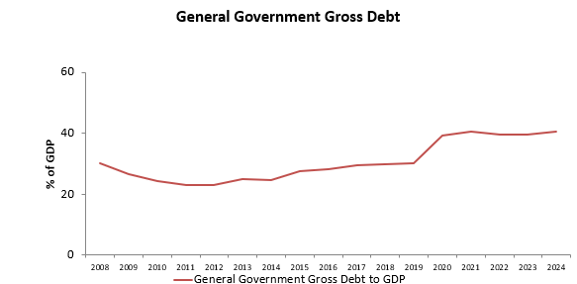
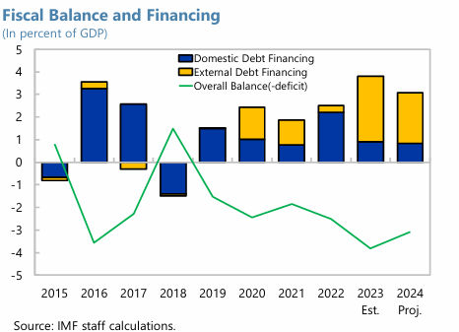
The stance is unsustainable due to limited financing options
Fiscal risks
Issuance of domestic bonds and depletion of cash reserves makes SI even more vulnerable to shocks
*
Notes:
What drives revenue Whats the key components in Expenditure The potential risks that come from this The trend in the PB
Fiscal policy. There is an urgent need to enhance the effectiveness of fiscal policy by addressing fundamental weaknesses in fiscal data and public financial management: a financing gap in the budget proposal should be eliminated, among others. Staff proposes to set a ceiling on the domestically financed primary budget deficit, which indicates that the 2025 budget should be tightened to start recovering cash buffers gradually. Domestic revenue mobilization is essential to accelerate investment in development priorities. Improving the transparency and accountability of public spending remains a priority, including through implementing the lessons learned from the pandemic stimulus package.
he Pacific Games also brought challenges. Faced with a cash crunch in the run-up to the Games, the government imposed strict controls on spending not related to the Games or the Constituency Development Funds (CDFs)2, crowding out other priority spending. The spending controls exacerbated delays in government payments to suppliers and vendors, posing a risk to financial stability (CBSI, Financial Stability Report 2H23). The government issued a significant amount of domestic bonds: the amount of public debt increased by 60 percent (2.7 percent of GDP) in 2023. Facilities built for the Games require significant maintenance costs down the road.
Solomon Islands has weathered the shocks of civil unrest, pandemic, and commodity price hikes, and achieved the milestones of hosting the Pacific Games in late 2023 and conducting peaceful general elections in April 2024. These achievements have raised the country's profile and strengthened national unity, but with costs—public debt has nearly tripled since before the pandemic, and the government's cash reserves have been significantly depleted. While staff expects continued modest growth in 2024 and 2025, medium-term growth prospects appear moderate and fiscal and current account deficits are expected to persist. Now is the time for the authorities to advance reforms to tackle the perennial challenge of stagnant per-capita income growth, while ensuring fiscal sustainability and resilience.
Fiscal deterioration due to the Pacific Games was less than previously expected, at the expense of other essential spending. Staff estimates a fiscal deficit of 3.8 percent of GDP in 2023, lower than projected at the time of the last Article IV Consultation, reflecting expenditure controls that crowded out spending other than for the Games and the CDFs, as well as additional donor support ahead of the Games (see Box 1).4 Nevertheless, the government issued a substantial amount of bonds and treasury bills, increasing the amount of gross domestic debt by 60 percent in 2023 (2.7 percent of GDP). The central bank purchased government bonds in the secondary market in late 2023 and early 2024 to improve its income position, which staff believes consequently helped the market absorb newly issued government bonds. The government's broader cash balance remained at a low level of SI$200 million, or 0.4 months of total spending in 2023.
The fiscal data have been substantially revised since the last staff report, including historical data. The CBSI has extended the coverage of the government finance statistics (GFS) grants revenue to include some off-budget donor grants, thereby enhancing consistency between the fiscal and BOP statistics. Expenditures have also been revised to account for spending funded by these off-budget donor grants. As a result, there are no significant changes in the fiscal balance up to 2020.
During November 11-December 2, 2023, Solomon Islands hosted the Pacific Games, a multi-sport event held every four years in the Pacific, for the first time. 5,000 athletes and officials from 24 countries and territories in Oceania gathered to compete in 24 sports events. It was a monumental and expensive event, requiring years of preparation, the mobilization of the full potential of all Solomon Islanders, and a large amount of money. COVID-19 further complicated the preparations. The government originally estimated the multi-year budget for hosting the Pacific Games, including the construction of facilities, at SI$2.5 billion, nearly one-fifth of GDP in 2019. The Pacific Games provided a valuable opportunity to build much-needed infrastructure with generous support from donors. Key projects funded by donors included a new regional airport, several major roads, a new wharf, sports facilities, including a new stadium, and other critical infrastructure upgrades. Increased construction activity in the run-up to the Games supported the country's recovery, while significantly widening the current account deficit. Hosting the Pacific Games has helped to rally national unity and enhance recognition of Solomon Islands. More than 11,000 visitors came to Solomon Islands in the fourth quarter of 2023, double the number in the previous quarter, laying the foundation for development of the nascent tourism industry. The Pacific Games also brought challenges. Faced with a cash crunch in the run-up to the Games, the government imposed strict controls on spending not related to the Games or the Constituency Development Funds (CDFs)2, crowding out other priority spending. The spending controls exacerbated delays in government payments to suppliers and vendors, posing a risk to financial stability (CBSI, Financial Stability Report 2H23). The government issued a significant amount of domestic bonds: the amount of public debt increased by 60 percent (2.7 percent of GDP) in 2023. Facilities built for the Games require significant maintenance costs down the road. Continued efforts by stakeholders are needed to leverage the legacy of the Games for future growth. First, the government should complete and report on an audit of Pacific Games-related funds. Facilities built for the Games should be handed over to appropriate agencies, along with sound plans for their effective use. The government should establish a system to ensure that the maintenance and management costs of these facilities are continuously funded as necessary.
Government financing is estimated to have remained tight in 2024, forcing the reintroduction of spending cuts. Expenditure continued to exceed revenue in the first half of 2024, reflecting pressure on recurrent spending, including for the general elections, and the withdrawal of donor support. In response, the government introduced measures to save a total of SI$250 million (1.7 percent of GDP) through spending cuts across ministries and agencies. Meanwhile, the government passed a SI$113 million supplementary budget (0.8 percent of GDP), mainly to seek approval for expenditures financed by additional donor support, as well as to address urgent drug shortages. As a result, staff estimates the budget deficit at 3.1 percent of GDP in 2024.
Staff anticipates a further increase in the budget deficit in 2025, with low cash reserves. In the 2025 Budget Strategy, the government expressed its commitment to safeguarding fiscal sustainability by reducing the budget deficit and rebuilding cash reserves, while accelerating investments to achieve resilient and sustainable growth. However, this commitment lacks concrete measures: the 2025 budget proposed by the government shows a larger deficit than the original 2024 budget, in addition to a sizable financing gap, raising concerns that the budget will again be under-implemented. Staff expects the fiscal deficit to result in 3.3 percent of GDP in 2025, larger than in 2024, assuming the reintroduction of expenditure controls and additional donor support. INTERNATIONAL MONETARY FUND 7 SOLOMON ISLANDS The strategy has no concrete plan to rebuild cash reserves.
Fiscal deficits are expected to persist over the medium term, raising concerns about the sustainability of domestic financing. The drivers of the deficits include expenditure needs to advance government priorities, maintenance costs for infrastructure, and continued weak revenue trends due to declining log exports. The public debt-to-GDP ratio is projected to continue rising, reaching the authorities' 35 percent threshold in the early 2030s. The Debt Sustainability Analysis (DSA) indicates that the overall risk of debt distress remains moderate, while the risk of external debt distress has improved from moderate in the previous DSA to low, reflecting better-than-expected export performance. Solomon Islands faces significant challenges and risks stemming from the government's low cash balance, an undiversified economic base, and vulnerability to natural disasters and climate change. It is expected that the country will rely increasingly on higher-cost and shorter-term domestic financing. This would not only significantly increase debt service costs, but also expose the government to various risks, including refinancing risks and crowding out of private investment, due to the low absorptive capacity of the economy and market.
Risks to the outlook are tilted to the downside (Annex I). Continued fiscal challenges— under execution of the budget due to a shortage of funding—could adversely affect the economy. Solomon Islands remains particularly vulnerable to extreme climate events and commodity price volatility, including due to the intensification of regional conflicts and deepening fragmentation. Risks of political instability remain, even after the peaceful elections and the subsequent formation of the coalition government. On the upside, additional donor assistance could support the new government's initiatives in its priority areas.

Slide 3
Debt is most prone to x
Notes:
Fiscal position : How has it changed over the years – is it expansionary or contractionary
Revenue: Main drivers are VAT & Luxury tax, income tax and international trade tax
Expenses: Compensation on employees || Use of G&S || Development expenditure
Balance : Prolonged budget deficit over 2016-2023 excluding {2018}
Risks: Growing public administration size & Falling investment expenditure
Fiscal policy stance: Procyclical or counter-cyclical
Debt sustainability: Is fiscal balance sustainable – is public debt too high
Risks to Fiscal sector

